Slide 1
STUDENT NAME: SAMRIN BANU. A
REGISTER NO AND NMID: 24132091802522031 And asanm20920924214031
DEPARTMENT: BSC [CS]
COLLEGE: COLLEGE/ UNIVERSITY: RAJESHWARI COLLEGE OF ARTS AND SCIENCE FOR WOMEN / ANNAMALAI UNIVERSITY

Slide 2
PROJECT TiTlE:
STUDENT PORTFOLIO :

Slide 3
AGENDA :
1.Problem statement
2.Project overview
3. End Users
4.Tools And Technologies
5. Portfolio Design And Layout
6.Features and functionality
7. Results And Screenshots
8.Conclusion
9.GitHub link

Slide 4
Problem Statement
In Today’s Academic and professional environments, Students are Expected to showcase their skilss , Achivements, and accademic progress in a structured and accesible format. Traditional methods
Such as printed resumes or static documents do not adequately reflect a student’s diverse experiences, evolving skilss, or creative work. Additionaly, there is often no centralized system for students to collect, organize and present their academic projects, certifications, extracuriicular activities, and personal growth over time.

Slide 5
PROJECT OVERVIEW:
This project aims to develop a digital platforms where students can create, anage, and showcase their academic and extracuriicular achievements. The system will allow uploading of projects, certificates, and personal information in an organized format. It enhances student‘s ability to present their skills to educators and employers. The platform will be secure, user friendly, and easily customizable.

Slide 6
WHO ARE END USERS ?
End Users Of The Student Portfolio System
Students- To create, update, and showcase their portfolios.
Teachers / Mentors – To review, give feedback, or endorse student work
Recruiters / Employers – To view student portfolios during hiring or intership selecion.
Academic institutions – To track student progress and achievement over time

Slide 7
TOOLS AND TECHNIQUES :
HTML – to structure the portfolio content (projects, achievements , etc. )
CSS – to style the portfolio with layouts, colours, fonts, and responsivesness
Javascript – To add interactively (form validation, dynamic sections, image galleries, etc.)
LocalStorage / SessionStorage – to temporararily store user data within the browser
Vs Code –as the code editor for development
Git+GitHub –for version control and hosting the project online.

Slide 8
PORTFOLIO DESIGN AND LAYOUT
Layout Structure
Header
Name, logo and navigation menu (Home, About, projects, Contact)
Fixed or sticky for easy access.
Hero Section
A Short intro with name, photo and a tagline
Call-to-action button (e.g., ‘View Resume’ or ‘Contact Me’ )
About Me
Brief bio
Skills (can be shown with progress bars or icons)
Projects Sections
Cards or grid layout displayong key academic or personal projects
Each card can include title, description, image and a ‘View More’ button.

Slide 9
FEATURES AND FUNCTIONALITY:
Core Features
Responsible Design
Works Smoothly On mobile,Tablet,And desktop devices.
Interactive Navigation Menu
Smooth Scring sections
Hamburger Menu for mobile view
Dynamic Project Display
Projects shown using Cards and modals
“View More” Buttons with toggle/show details.
Skills & Progress Bars
Animated skill Bars or icons to show proficiency.
Contact Form
Form with fields(Name, email, message)
JavaScript form validation before submission

Slide 10
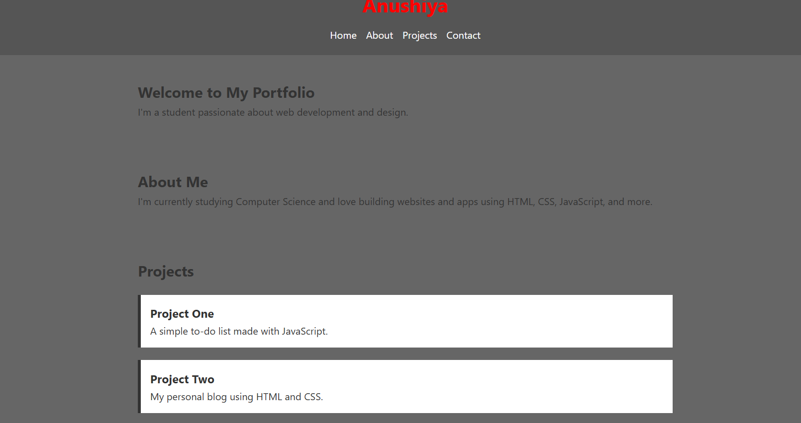
Results And Screenshots :
Samrin Banu . A

Slide 11
Conclusion
This student portfolio provides a simple yet effective way for students to showcase their skills , project, and achivements online. Built using only HTML, CSS, and JAVASCRIPT , it ensures a responsible and Interactive user experience. The platform enhances Personal branding and helps students stand out To educators and employers.

